Slide 1
Civic Learning & Democracy Engagement Coalition (CLDE)
Engaging Our Students With Democracy’s Future:
Why We Must and How We Can
Carol Geary Schneider, President Emerita
American Association of Colleges & Universities

Slide 2
For Our Future – and a World Shared in Common
“The struggle is a never-ending process. Freedom is never really won. You earn it and win it in every generation.”
Coretta Scott King
Notes:
2

Slide 3
Our Topics For This Conversation
Civic Inquiry and Democracy Engagement in College:
    The Fraught National and Global Context
    What Earlier Leaders Knew – and Policy Priorities Now
    From “A Crucible Moment” to a New CLDE Coalition
    Making College Civic Learning Equity-Committed: Goals, Priorities and Connections to Student Success
    Guided CLDE Pathways for General Education and Majors– Linking Core Competencies with Students’ Collaborative Work on Public Questions and Projects
Notes:
3

Slide 4
The Fraught National and Global Context
At Home and Abroad: Democracy as a Way of Life is Under Siege. Aggressive – and Brutal - Authoritarianism is on the March.
Democracy Faces Urgent Challenges: Climate, Health, Poverty, Social Distrust, Deep Inequities, Struggles for Justice and Voice, and More….
Young Americans (Under 30) Describe Our Democracy as:
“In Trouble” (39%) or “Failed” (13%). Harvard IOP Youth Poll, Fall 2021.
Freedom House 2022 points to 16 Years of Democracy Regression Around the Globe – and Lists U.S. Democracy as “In Decline.”
Notes:
4

Slide 5
The Higher Education Context
On Campus: We Can Celebrate 3 Decades of Progress to Advance Civic Learning Across All Forms of Postsecondary Education.
Spectacular Leadership from Many Faculty, Staff, Students, and Community Partners. Civic Learning Changing Lives for the Better.
BUT Civic Inquiry Remains Elective with Millions of Students Never Participating. Democracy Learning Struggles for Resources – as Does the Entire Public Education Sector.
Notes:
5

Slide 6
Policies Priorities: Past, Present, Future....
From the Founding Era Through the Truman Commission in 1947: Higher Education’s Democracy Mission was Celebrated.
Today, Policy Touts ROI or Economic Return on Investment.
Policy Message:
From Get a Degree, Get a Job, Give Back,
To Get a Degree, Get a Job, Get Ahead. (Real Story)
Today, Everyone Can See that Democracy Needs Repair. The Time is Right to Make Civic Learning Both Expected and Inclusive.
Notes:
6

Slide 7





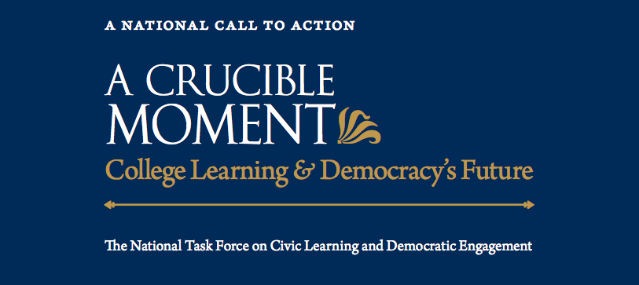
From Crucible Moment (2012) to a New CLDE Coalition
Notes:
7

Slide 8

CLDE’s Shared Commitment Statement
Democracy Learning is a Top Priority for Postsecondary Education.
Notes:
8

Slide 9

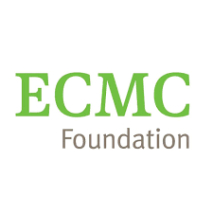




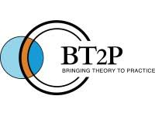


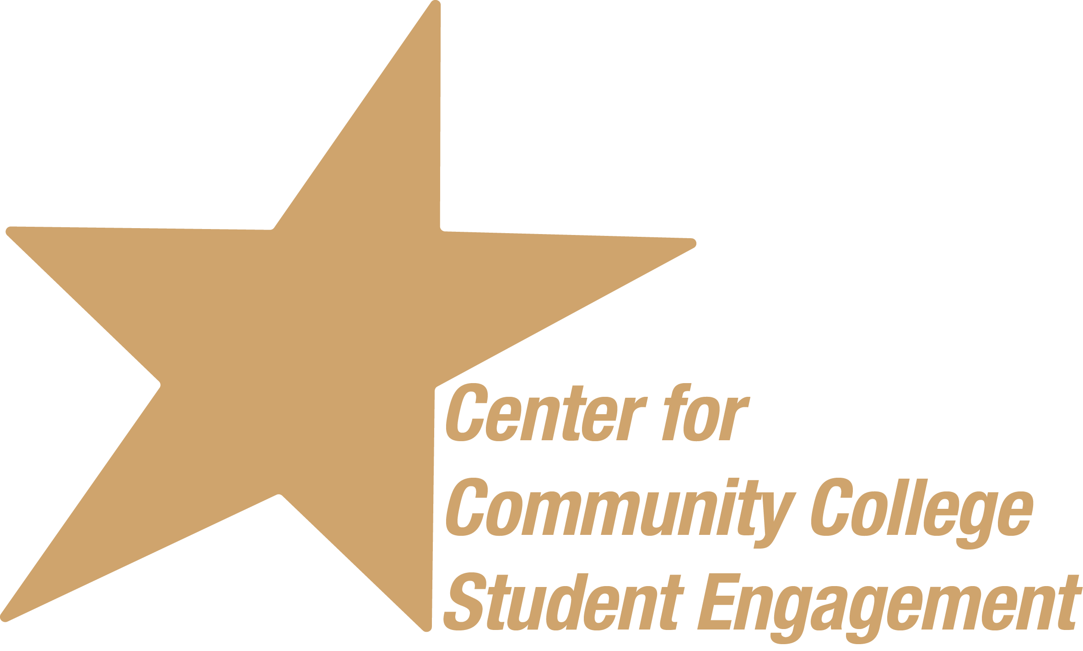






Shared Commitment Endorsed by Over 70 Partners
Notes:
9

Slide 10
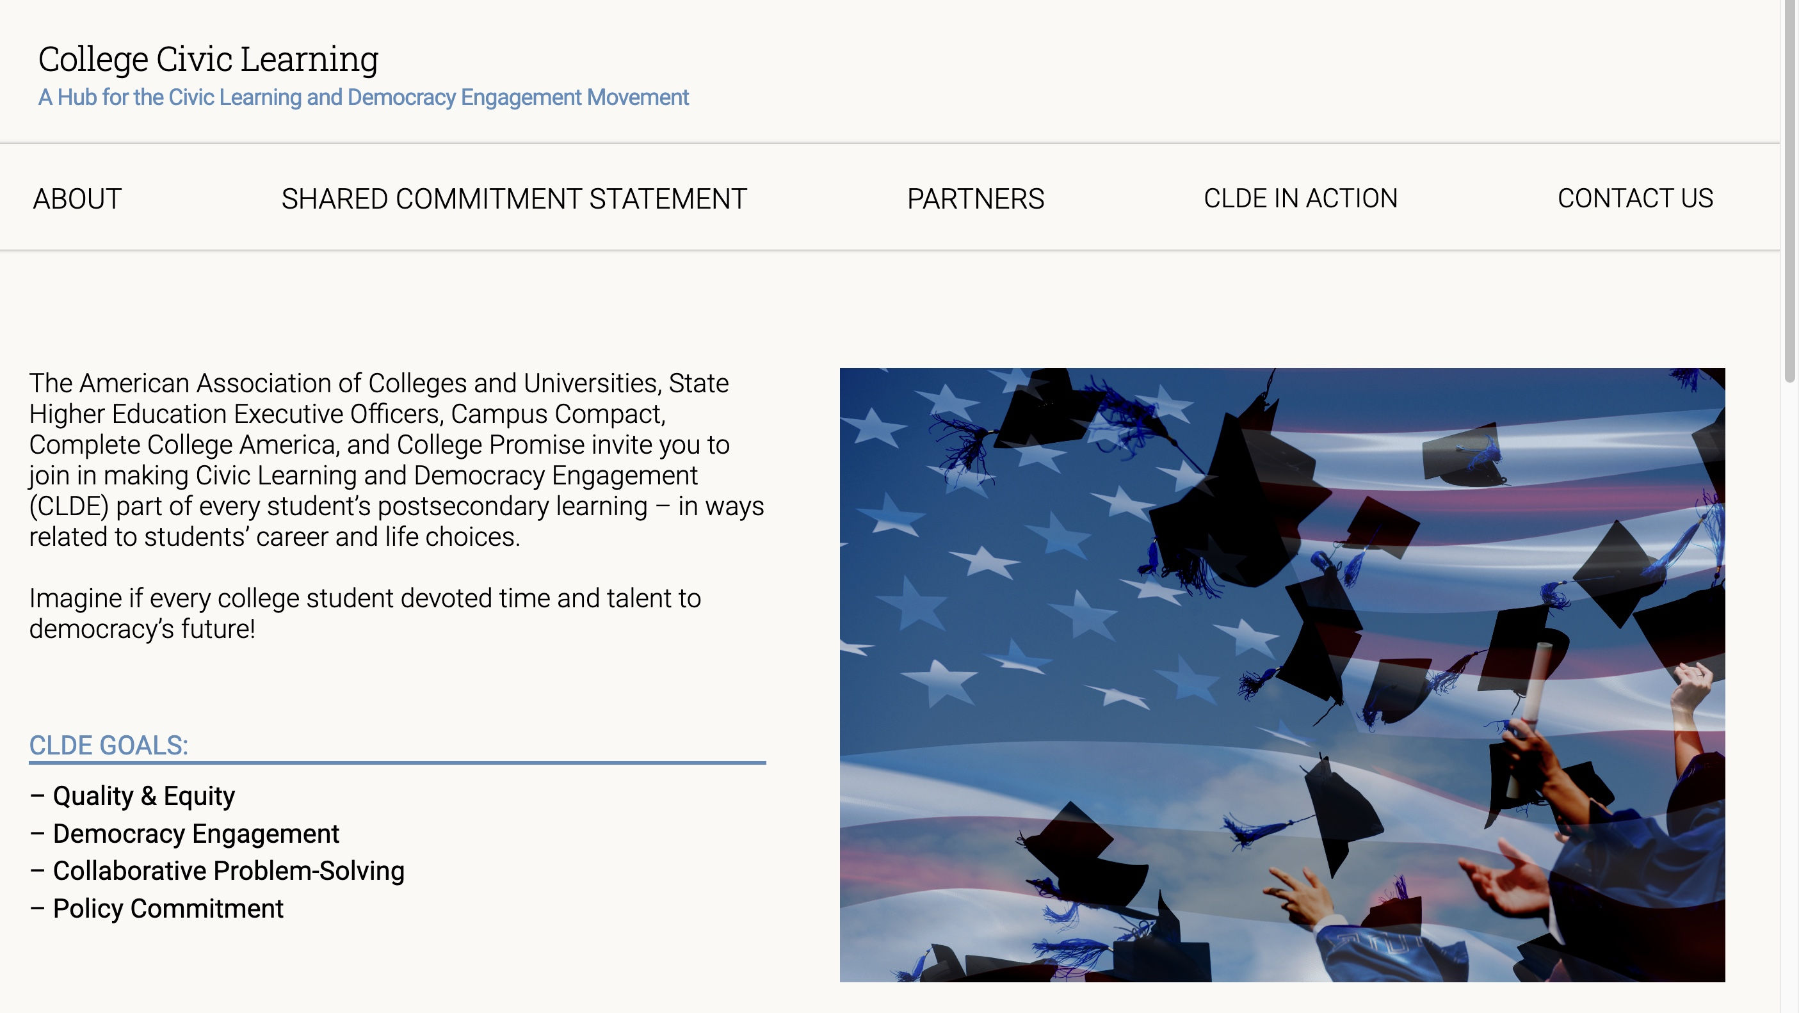
www.collegeciviclearning.org
Notes:
10

Slide 11
Making College Civic Learning Equity-Committed
Quality & Equity: Build commitment and capacity—across postsecondary education—to make civic learning and democracy engagement an expected part of a quality college education for all college students, with equitable participation by students from underserved communities a top priority.
Democracy Engagement: Engage students with democracy’s future in a diverse United States, in U.S. communities still struggling to reverse inherited disparities, and in a globally interdependent world where authoritarianism is on the rise.
Collaborative Problem Solving: Prepare each postsecondary student, through creative combinations of general education, arts and sciences, and career-related studies, to work directly on selected public problems that society needs to solve—e.g., problems in racial healing, health, education, housing, climate, digital access, human rights, justice systems, interfaith cooperation, and more.
Policy Commitment: Secure policy support for and investment in the goals listed above.
Notes:
11

Slide 12
From Our Website: Civic Learning Macro Initiatives
The initiatives featured here each are working to take Civic Learning and Democracy Engagement “to scale.” Collectively, they show the spread of vigorous leadership to make CLDE pervasive and inclusive.
The Civic Learning and Democratic Engagement Action Network: The organizations in this network have been long-time leaders in advancing civic learning and/or democratic engagement as a national priority.
Higher Learning Commission: The Higher Learning Commission (HLC) The nation's largest institutional accreditor with 967 members, HLC in 2020 made civic engagement one of its quality standards for the renewal of accreditation. Reference Document
State of Massachusetts: The Massachusetts Department of Education (MDE) In 2014, Massachusetts became the first state to make civic learning one of its expected college outcomes for public higher education. Reference Document
Notes:
12

Slide 13
Civic Learning Macro Initiatives
State of Virginia: State Council for Higher Education in Virginia (SCHEV). In 2017, SCHEV asked all its member institutions to assess students' civic engagement as a “required competency.” Reference Document
State of Florida: Since 2019, Florida leaders have taken action to strengthen students' civic learning in both K-12 and postsecondary public education, including career programs. Reference Document
State of Maryland: University System of Maryland (USMD). Since 2017, USMD has been working at the system and campus level to advance students' civic engagement and learning across public higher education.” Reference Document
Notes:
13

Slide 14




Campus Examples of Civic Learning for All
CLDE and Completion Evidence:
The Metro College Student Success Program at
San Francisco State University
CLDE in Two-Year Institutions:
College of the Canyons
Kingsborough Community College
Community Colleges for Democracy (9 Case Studies)
CLDE in Four-Year Institutions:
California State University Monterey Bay
James Madison University
Portland State University
Providence College
St. Mary’s College of California
Southern Methodist University
University of Nebraska-Lincoln
University of Wisconsin—Oshkosh
Worcester Polytechnic University

Slide 15
Where Civic Learning Can Happen
Advancing From “Pockets of Good Practice” to Making CLDE Inclusive
        Equity Initiatives
        Students as Change-Makers: Working Collaboratively on Democracy’s Big Challenges; Blending their Career Preparation with their Community-Based Projects and Research
        General Education
        Civic and Democracy Inquiry – US and Global
        Majors
        Public Questions and Collaborative Civic Projects with Diverse Community Partners
        Campus Culture
        Modeling and Guiding Civil Discourse Across Difference About Democracy’s Many Big Challenges
Notes:
15

Slide 16
Creating Guided CLDE Pathways For All University Students
Advancing From “Pockets of Good Practice” to Making CLDE Inclusive
Many Institutions have Identified Expected Learning Outcomes--Capacities that Graduates Need Both for the Modern Economy and Even More, as Participants in a Democracy Desperately in Need of New Creativity and New Determination to Solve Problems Together. Analysis, Evidence-Based Reasoning, Communication, Engaging and Negotiating Difference, etc.
The Next Step is to Connect the Needed Capacities with Assignments and Projects So Students Gain Democracy Learning in General Education, Majors, and Campus and Community Life.
Notes:
16

Slide 17
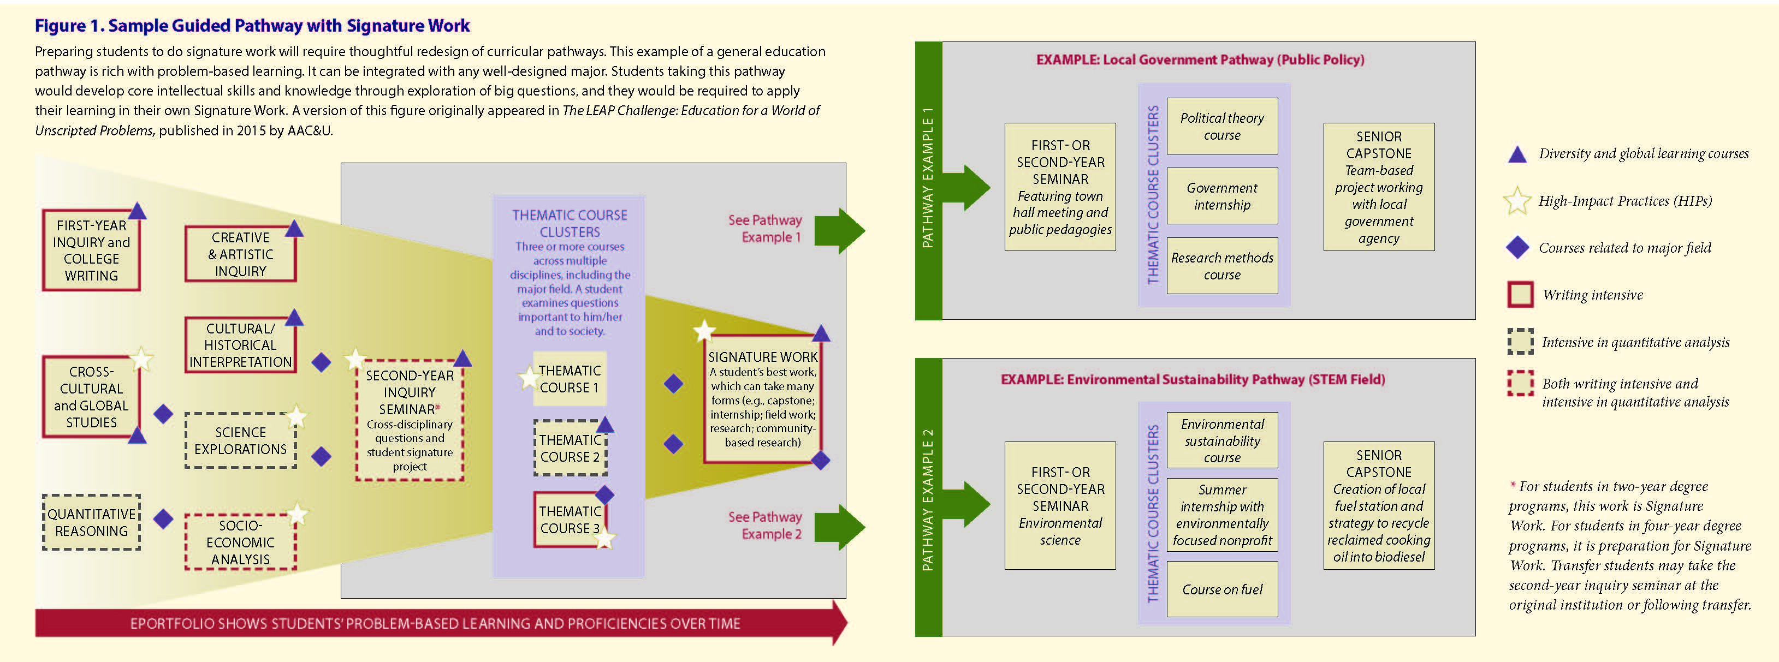

Slide 18
To share your own civic and
democracy work with CLDE, please write
Carol Geary Schneider at cgs@aacu.org.
Thank You!

